Slide 1



WELCOME TO THE CIRCLE OF YOUNG INTRAPRENEURS
TIM HEARD & DAVID SPEARS
CO-FOUNDERS
iLead - Inspire
X
#DOWELLDOGOOD
Internal Only

Slide 2
THE THEORY
THE TALE
THE TAKEAWAYS

Slide 3
THE THEORY
Internal Only

Slide 4


The world is full of BIG problems

Slide 5


OVER CONSUMPTION

Slide 6


ACCESS TO WATER

Slide 7


DEFORESTATION AND CLIMATE CHANGE

Slide 8


POLLUTION

Slide 9
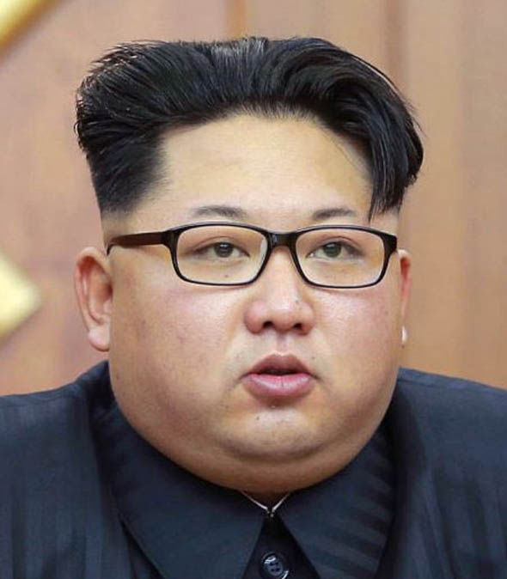


THESE GUYS

Slide 10

Why are we having so much trouble solving these problems?

Slide 11
What is the role of business?

Slide 12

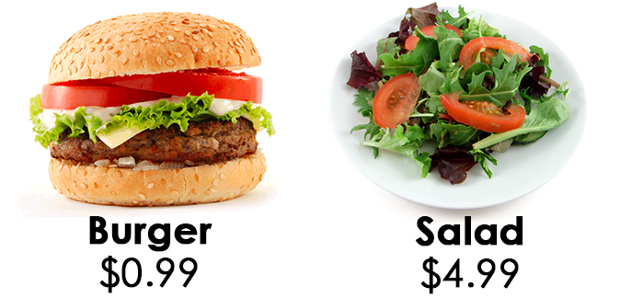
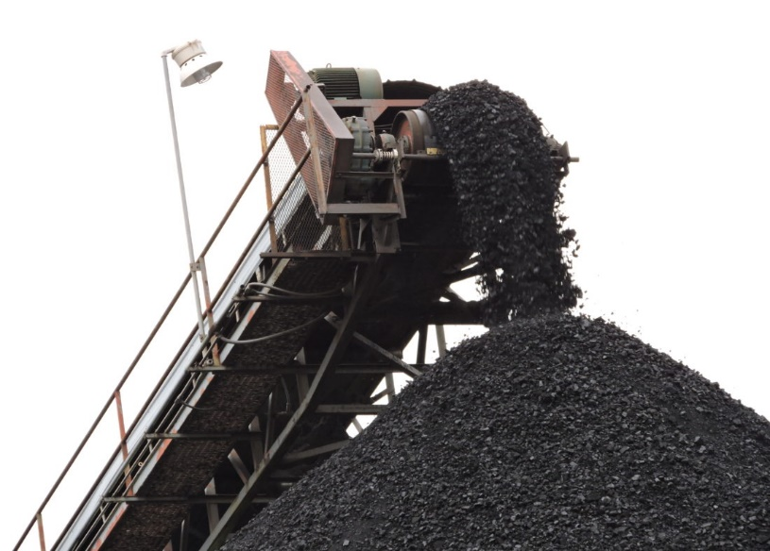


Business is seen as the problem…
BAD ACTORS

Slide 13



Where are the solutions?
Reality is we’re not making fast enough progress

Slide 14
The fundamental problem is…
SCALE

Slide 15
RESOURCES
The fundamental problem of SCALE is…
Not enough money to deal with problems at scale
Not enough tax money
Not enough philanthropic donations

Slide 16

Where are the resources?
Business creates WEALTH when it MEETS NEEDS at a PROFIT
Taxes
Incomes
Charitable donations

Slide 17
Where are the resources?
Total revenue by stakeholder, United States
Non-Profits
Government
Non-profits - $1.2 Trillion
Government - $3.1 Trillion
Corporations - $20.1 Trillion
Corporations

Slide 18

Profit is the…
MAGIC
Profit allows solutions to be infinitely scalable
Solution becomes self sustaining

Slide 19

Conventional Wisdom
Business profits from CAUSING social problems

Slide 20

The Reality is Opposite
Business profits form solving social problems
Pollution – reducing emissions saves money, improves image and makes business more productive & efficient ultimately driving profit
A fundamental deep synergy if you’re not thinking in the very short run

Slide 21

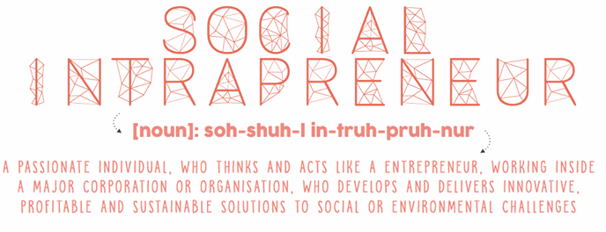
How do we use the power of business?
The LARGEST opportunities we see for business’s today is to solve social problems

Slide 22
Our Purpose is to Create Shared Value
Addressing a SOCIAL ISSUE with a
BUSINESS MODEL
Social Value + Economic Value

Slide 23
Solutions
Change how others see business
Change the way business sees itself

Slide 24
WHY IS SOCIAL INTRAPRENEURSHIP IMPORTANT?

Slide 25


INDIVIDUALS
SOCIETY
DEVELOPMENT: DO WELL
PURPOSE
VALUE
MEANING
IMPACT: DO GOOD
SHIFT THE ‘OIL TANKER’
SUSTAINABILITY
WORKING CULTURE

Slide 26
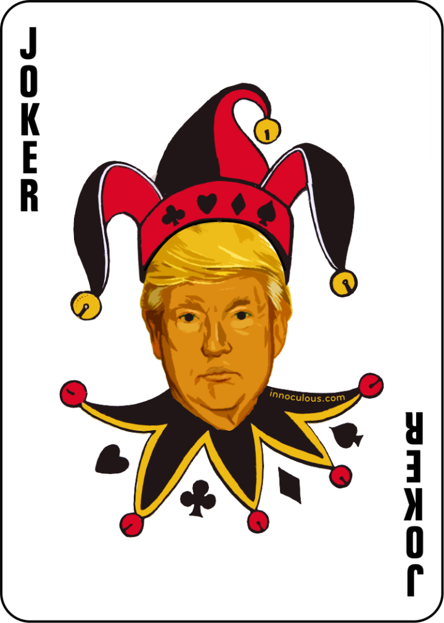
Talent Management
Leadership Development
Innovation Trajectory
Reputation & Brand
Growth
The TRUMP Card – why social intrapreneurship is important to corporates

Slide 27

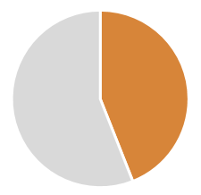





SOME MATHS
Achieving the SDGs requires business involvement and, in fact, represents a business opportunity.
Companies struggle to attract and retain talent
AND
Cost per leaver £30,000
Annual cost to the UK economy £4.1b
(The Telegraph, 2014)
BUT
Millenials are 5x more likely to stay at a company which has clear purpose and positive social impact
5
X
Currently 44% of millenials say they will leave their company within the next 2 years
WTF?
Notes:
"in the UK the average cost to replace a departing staff member is £30,614 costing the British economy alone £4.13bn each year'
Staff turnover costs British businesses at least £4.13bn every year as new employees take up to eight months to reach optimum productivity levels, according to research released today.
The average fee for replacing a departing staff member is £30,614, says Oxford Economics and income protection providers Unum. This figure comprises two typical amounts – £5,433 for logistics, such as agency fees and advertising, and wages during the time when a new employee is yet to reach optimum productivity level, believed to be an average of 28 weeks at a cost of £25,182.
(The Telegraph, 2014)

Slide 28

RESPONSIBILITY?

Slide 29
THE TALE

Slide 30
BARCLAYS ROUNDUP

Slide 31



Barclays RoundUp is a collaborative micro-donation initiative that facilitates a virtuous cycle amongst our customers, social enterprises and Barclays
An optional bolt-on feature to existing Barclays products which creates a new donation mechanism
Funds go towards customer’s choice of social impact portfolio
Win, Win, Win
Doing good, profitably, in a way that’s convenient & simple for our customers
WIN
Donate conveniently without any change to purchasing behaviour or customer journey
Opportunity to integrate “do good” with everyday purchases and lifestyle
Enables customers to explore meaningful and impactful ways to spend spare change
Post MVP, further options such as potential to channel funds toward savings and investments
Customers
WIN
WIN
Potential to raise £millions for good causes at scale
Opportunity to develop relationships with customers and Barclays for further engagements
Opportunity to delight customers whilst achieving our 5C’s objectives
In particular, potential to drive key financial benefits at minimal cost
Millennial colleague retention
Society
Barclays
Barclays RoundUp supports an intuitive customer journey with no change required in customer purchasing behaviour
Opt-In
Customisation
Donate
Socialisation

Slide 32
Even if only a fraction of current Barclays customers adopt Round-Up the social impact would be very significant; if Round Up was made available to Barclays wide products the social impact would be incredible
Significant financial impact even with minimal adoption rate
c23m
X
2%
X
£2
=
£11M
Current Active Card Customers in Barclays UK
Average donation per month per user
Total donation per annum
Adoption Rate
Annual Collaborative Donation to Social Enterprises
Average RoundUp per Customer per Month | Adoption Rate
 | 1% | 2% | 5% | 10%
£1 | £2,760,000 | £5,520,000 | £13,800,000 | £27,600,000
£2 | £5,520,000 | £11,040,000 | £27,600,000 | £55,200,000
£5 | £13,800,000 | £27,600,000 | £69,000,000 | £138,000,000

Slide 33
WHO ARE THE CIRCLE OF YOUNG INTRAPRENEURS?
Internal Only

Slide 34
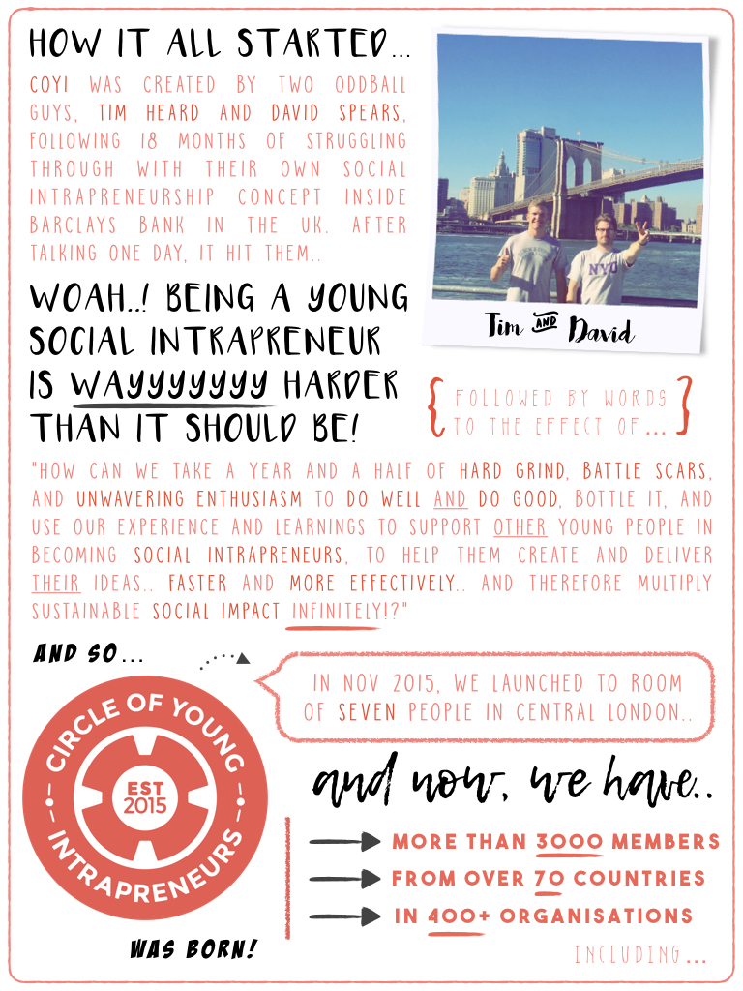

Slide 35
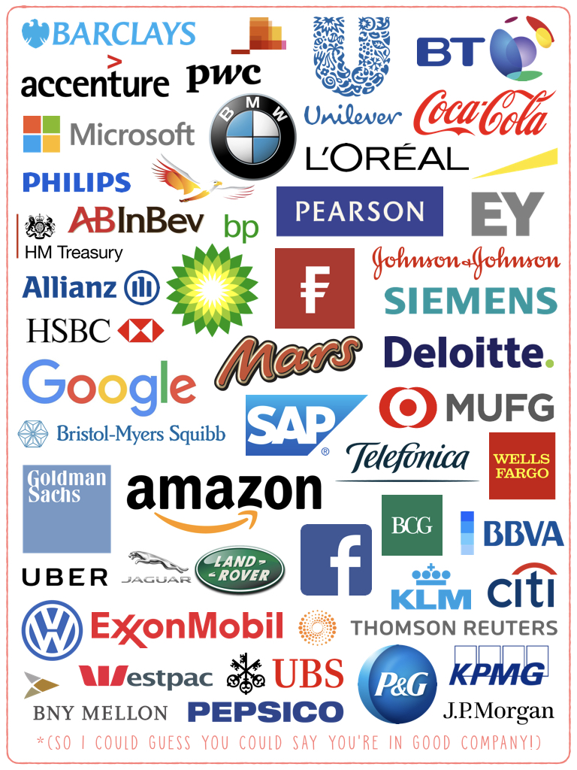
Internal Only

Slide 36
Circle One Pager
Get latest from dropbox

Slide 37
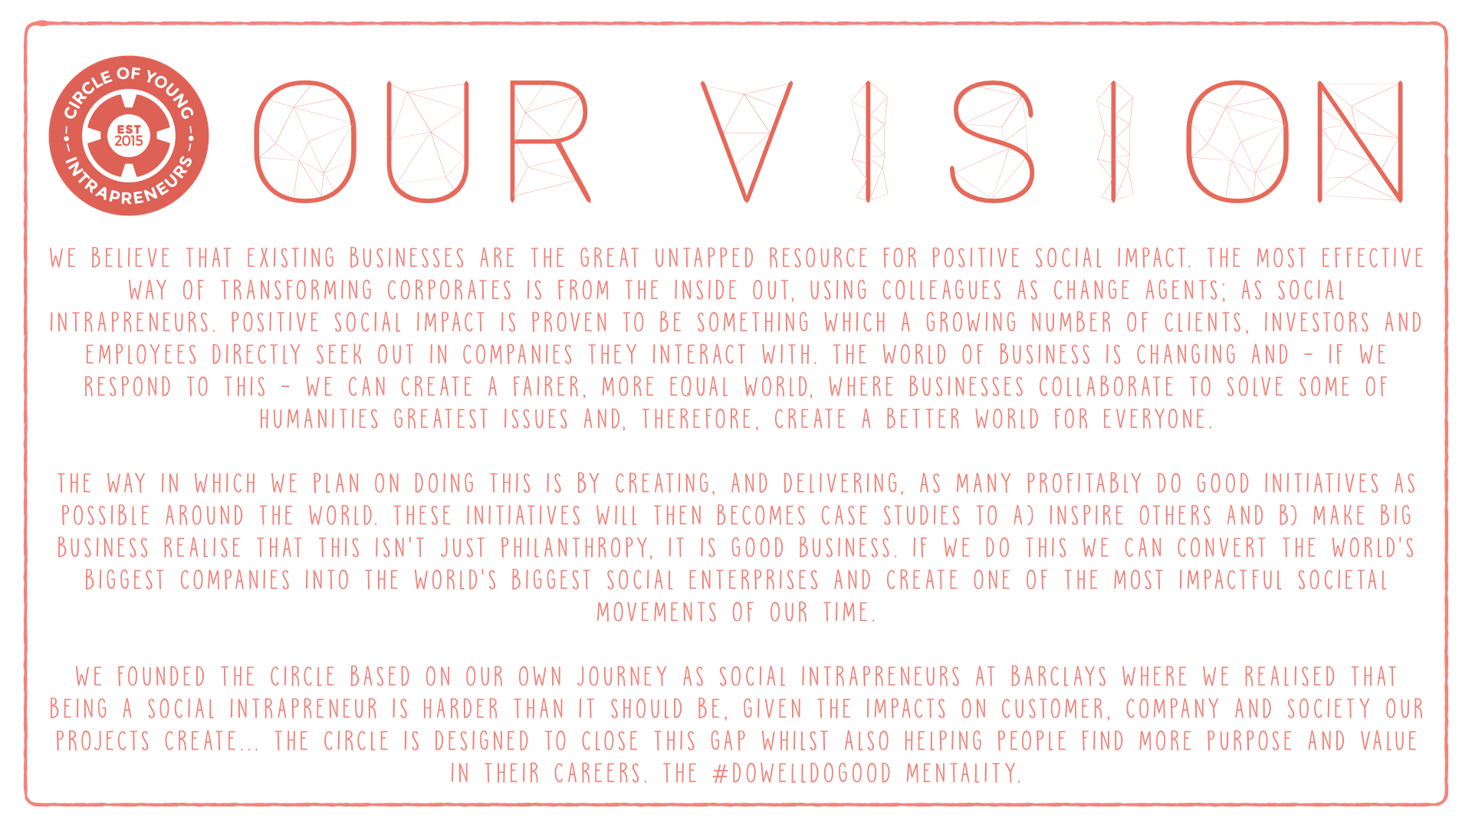

Slide 38
Circle Map
Get latest from dropbox

Slide 39
THE TAKEAWAYS

Slide 40
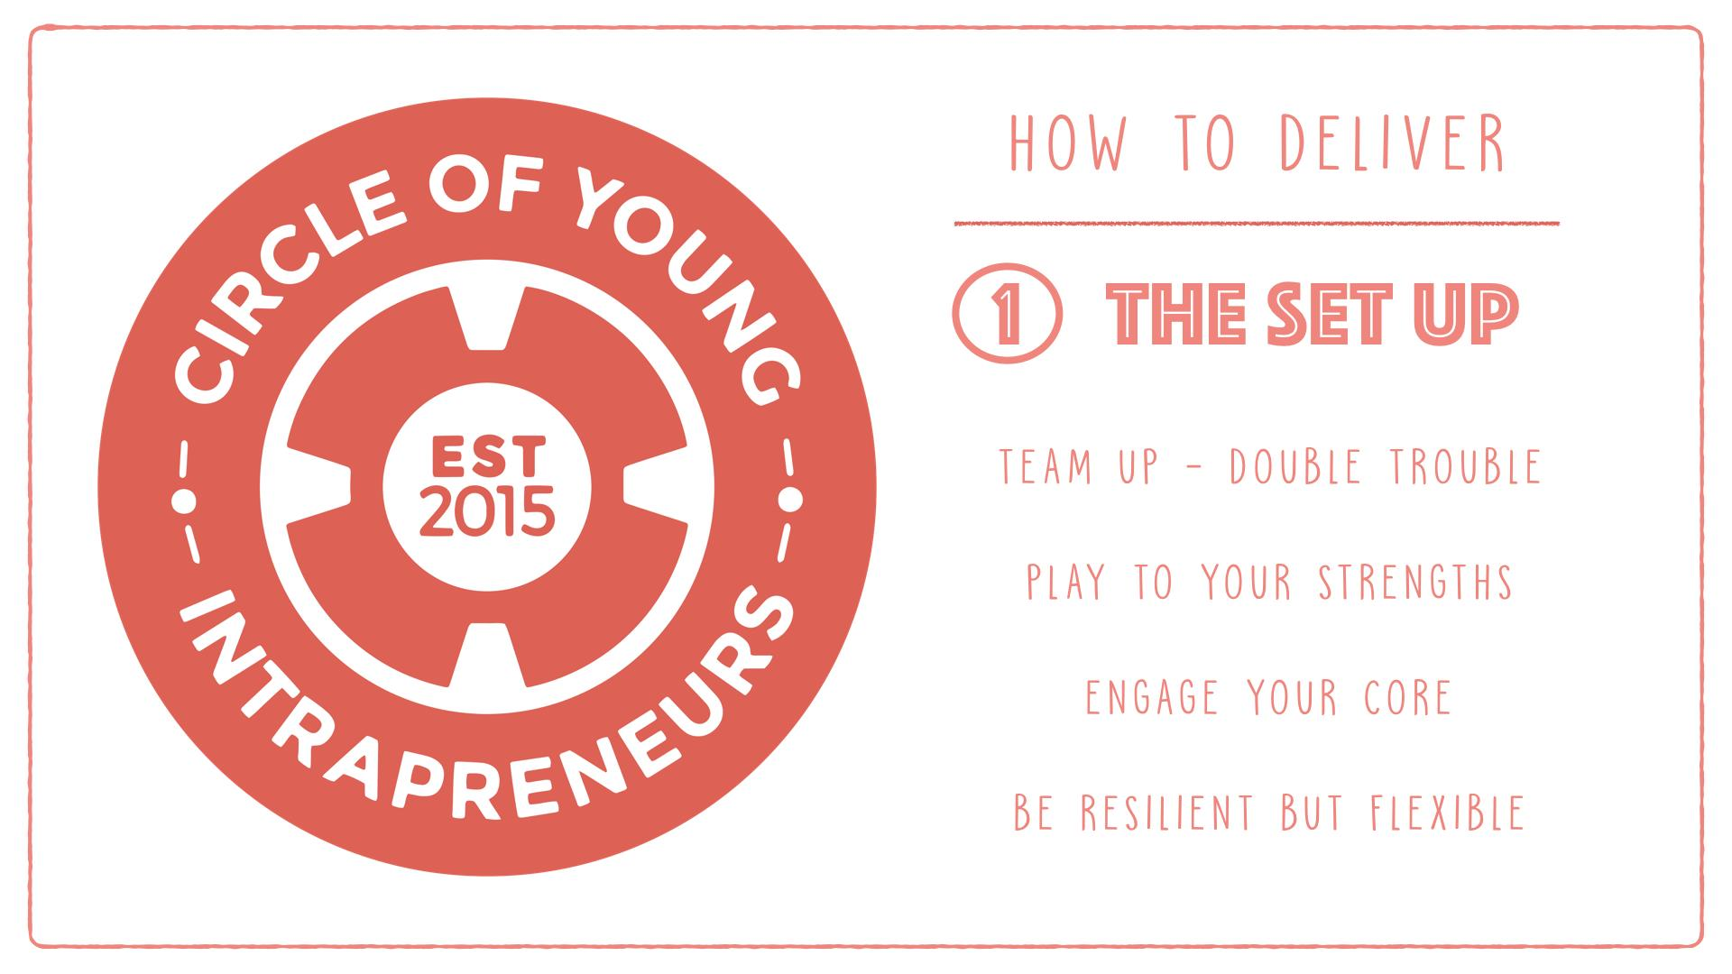

Slide 41
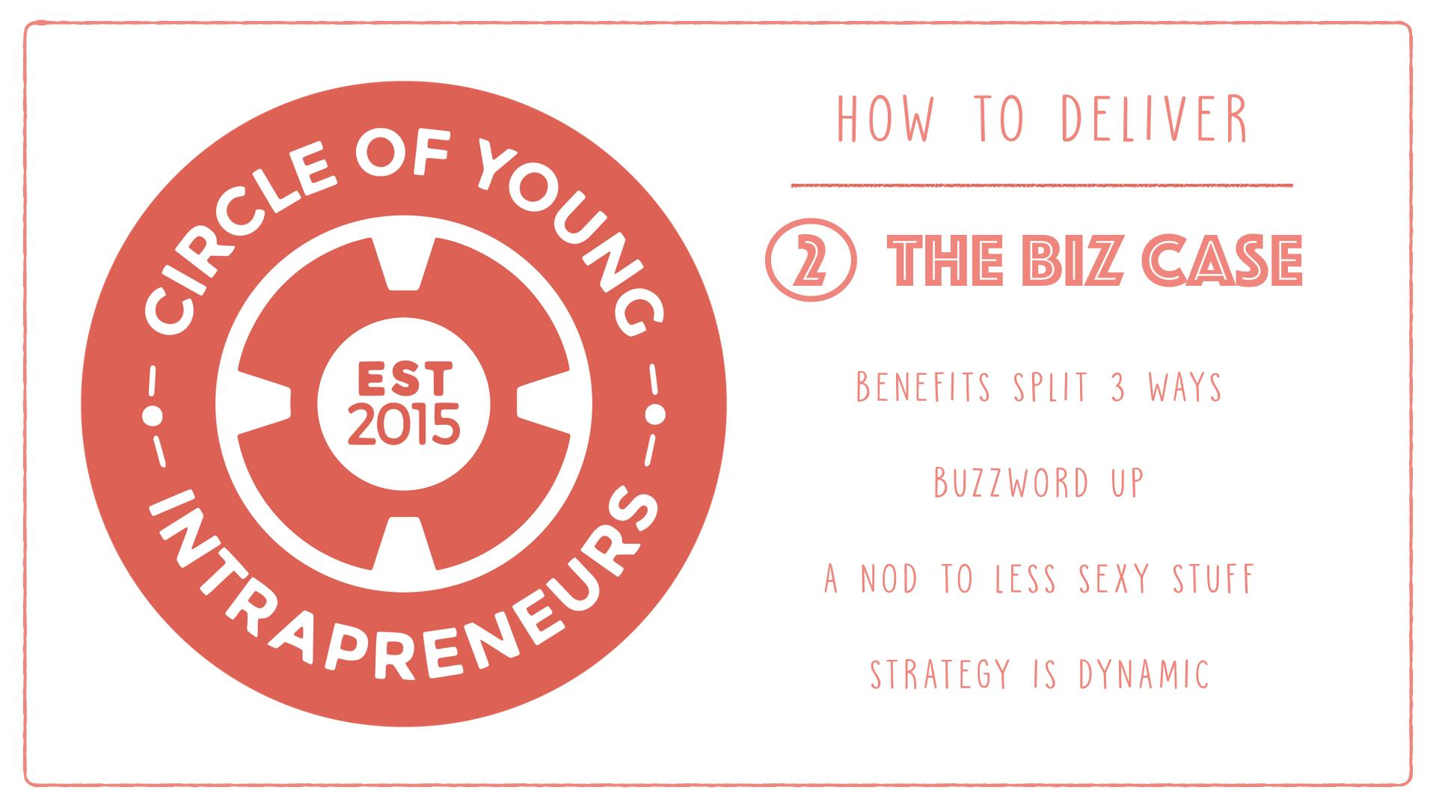

Slide 42


Slide 43
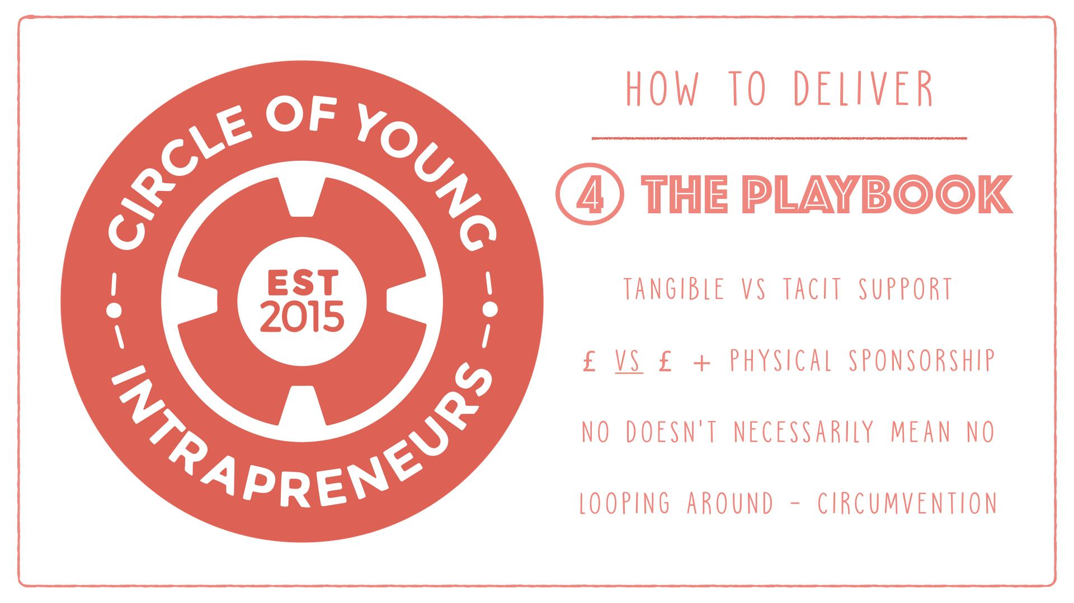

Slide 44
Insert fixed takeaways for audience

Slide 45

JOIN US
WWW.CIRCLEOFYI.COM
@CIRCLEOFYI
WANT TO BECOME A CIRCLE LEAD FOR YOUR CITY? EMAIL US TIM@CIRCLEOFYI.COM

